Slide 1
Daily Scrum
08/03
Han Sang Lee Java A-4 SK Didimdol 4th hillofsky@naver.com

Slide 2
Task List
Assigned Task | Progress
Data Modeling: Class Diagram | 20%
Database Design | 0%
UI Design: 마이페이지, 개인정보수정 | 100%
Product Backlog 작성 | 100%

Slide 3
Yesterday’s Task
Today’s Task
Technical Issue

Slide 4
1. Yesterday’s Task
What I did?
Class Diagram 업데이트

Slide 5
1. Yesterday’s Task
How I did?
Class Diagram 업데이트
08/02 회의 내용 반영
후기를 저장할 테이블
예약된 날짜를 저장할 테이블

Slide 6
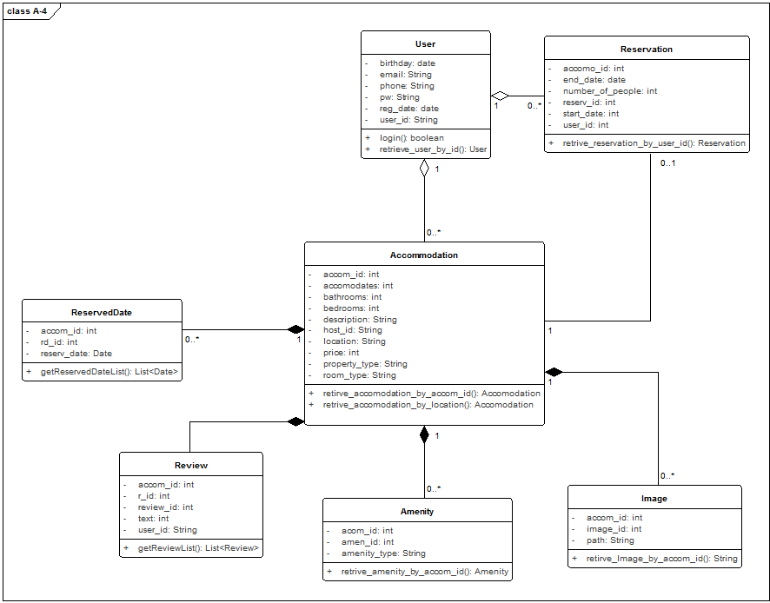
1. Yesterday’s Task
Result

Slide 7
Yesterday’s Task
Today’s Task
Technical Issue

Slide 8
2. Today’s Task
ToDo
DB 서버 셋업
DAO 작성 및 테스트
SRS 작성
개발환경세팅

Slide 9
Yesterday’s Task
Today’s Task
Technical Issue

Slide 10
3. Technical Issue
Issue
(None)

Slide 11
END

